Slide 1
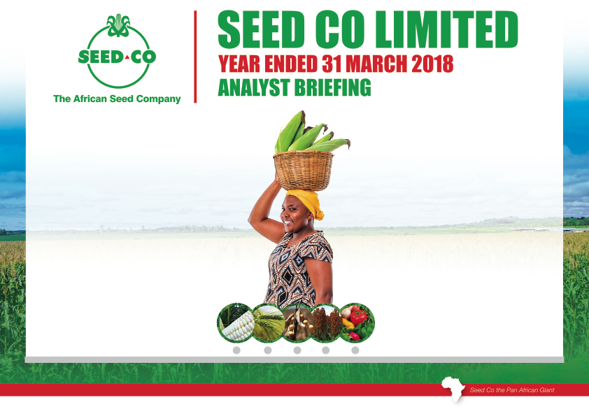

Slide 2
Seed Co Group
Full Year Financial Review
By
Matorofa John- GFD

Slide 3
Income Statement
For the Year ended
March 2018

Slide 4
Overview
Regional business under Seed Co International to be unbundled & are disclosed under Discontinued operations

Slide 5
Income Statement Review

Slide 6
1. TURNOVER
Down 5% due to:
Product shortages caused by seed production challenges
Improved volume of winter cereals and Soya beans mitigated the decline

Slide 7
Consolidated Maize sales volume trends - mt

Slide 8
Sales Volume Contribution by Country

Slide 9
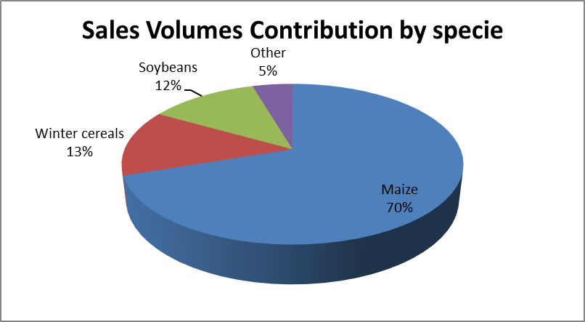
Sales Volume Contribution by Specie

Slide 10
2. Margins
Overall Gross Margins remained unchanged due to
Increased volume of lower margin winter cereals and soya beans
Reduced volume of high margin long season varieties

Slide 11
3. Other Income
This is made up of commission, non seed sales, doubtful debt recoveries. The massive jump was due to
Increased volume of commission based sales and non seed sales

Slide 12
4. Overheads
Operating costs up 1% due to :
Increased R&D activity at the new research stations
Increased sales and agronomy activities during the selling season
Group restructuring activities underway

Slide 13
5.1 Net Finance Income
This more than doubled due to the strong cash position at the beginning of the year which delayed use of facilities during the year
5.2 Associate Income
The improvement was due to increased volume of cotton seed sales to Zimbabwe Government inputs programe

Slide 14
Overall Earnings up due to
Increased other income from commission based sales and exchange gains.
Reduced finance costs
Strong performance of the associate cotton seed business

Slide 15
Statement Of Financial Position
As at
31 March 2018

Slide 16
Overview
Individual asset and liability values decreased as the regional balance sheet was classified as
“held for distribution” because of the impending unbundling of Seed Co International.

Slide 17
1. Assets Breakdown

Slide 18
1.1 PPE
The reduction was due to reallocation of $42m of PPE for the Regional operations to Assets held for distribution.
Capex of $7,9m during the year was spent on:
Acquisition of land in Zambia and Botswana for production and future construction of a warehouse respectively;
capital improvements at various research stations;
purchase of vegetable seed processing and packing plant by Prime Seed;
renovations at the factory in Zambia;
replacement of processing equipment in Zimbabwe and completion of the Kenya facility which was commissioned last year.

Slide 19
1.2 Current & Non current Financial Assets
These are primarily TBs of which $12,26m are maturing in the F19/20 Financial year and the remainder in current assets maturing in the F19 financial year.
Increase is due to TBs received during the year in settlement for the sales to Zimbabwe Gvt during the year

Slide 20
1.3 Inventories
The reduction is mainly due to reclassification of inventories amounting to $13,7m for the regional business included in Assets held for distribution .
The inventory on hand is mainly winter cereals , vegetable seed and foundation seed stocks

Slide 21
1.4 Accounts Receivable
The reduction in trade receivables is mainly due to $36m for the regional business included in Assets held for distribution in addition to aggressive collections
TRADE AND OTHER RECEIVABLES |  | Group
 |  | 2018 | 2017
 |  | US$ | US$
Trade receivables |  | 919,690 | 41,780,411
Prepayments |  | 6,236,638 | 5,687,122
Seed grower advances |  | 9,155,163 | 6,296,700
Other receivables |  | 2,703,157 | 9,738,872
 |  | 19,014,648 | 63,503,105

Slide 22
1.5 Cash and Cash equivalents
Decreased due to:
Dividend payments
Increased Seed production & Grower payments for seed deliveries
Capital expenditure & inputs procurement
1.6 Borrowings and Trade payables
Borrowings reduced as most of the operations were funded from cash resources during the period

Slide 23
1.7 Net Assets For Distribution Breakdown

Slide 24
Seed Co Group
Operations Review
by
Morgan Nzwere : GCEO

Slide 25
General environment
Season presented many challenges at all production centres, all working against growers leading to overall yield losses of close to 23%. :
  high disease pressure,
  poor pollination due to high temperatures at pollination stage followed by excessive rainfall when seed crops were coming to maturity, and
  high incidence of fall army worm.

Slide 26
Research
Progress made in registration of varieties under COMESA catalogue:
  11 maize varieties
  4 soya varieties on
Molecular genotyping lab optimised and operations enhanced,
  Consequently, the breeding programs have begun deploying molecular markers in breeding projects
The first generation of MLND tolerant hybrids have been submitted for registration in Kenya while 7 hybrids submitted to the NPT in Kenya were progressed to first and second year of testing.

Slide 27
Production
Product demand outstripped supply in all markets leading to critical shortages
The Group is targeting a 40% maize seed production increase.
Challenges for production still being experienced:
  High disease pressure,
  poor pollination due to high temperatures experienced.
  Erratic rainfall

Slide 28
Processing
The Group is exploring cob harvesting and seed drying technology to speed up seed availability and contain diseases associated with late harvesting
All seed processing plants in good working condition across the group
Additional seed processing facilities to be set up in East Africa to increase capacity for this growing market

Slide 29
Sales & Marketing
Total Volumes sales same as prior year
Maize volumes down due to product shortages in all markets
Winter cereals sales more than doubled due to high demand and improved power

Slide 30
Sales & Marketing

Slide 31
Development files
Nigeria
  Seed production more than doubled
  Seed growers now showing signs of improvement
Ethiopia
  Still chasing the business license. Recent Developments show political will to attract new investors and a breakthrough is Eminent
Ghana
  The Group now has a physical presence in Ghana to be used as a spring board to develop Francophone West Africa territory using already registered products

Slide 32
Development files contd
Vegetables
  JV with HM Clause now operational in most markets
  JV has now been capitalized in order to develop the new markets
  Breeding and testing program commenced

Slide 33
SBU Updates
Zimbabwe
  Got a lion’s share of the GVT business again this year with high demand for premium varieties by commercial farmers
  Business in stock-out position
  Demand for winter cereals and Soybeans rebound following inclusion of these in the Govt input program

Slide 34
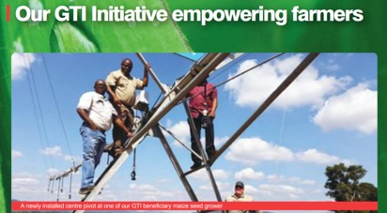
SBU Updates- Zimbabwe
Seed Grower Capacitation
Working capital & inputs support
Centre pivots
Seed drying units
Seed graders
On farm weather stations
Tractors, planters
Grading sheds
Silos etc

Slide 35
SBU Updates- Zimbabwe
Seed drying units
Bulk Drier units at Marius Groove, Balchutha Farm in Chegutu
Silo Drier at Percy Mazike’s Rastal Farm in Chegutu

Slide 36
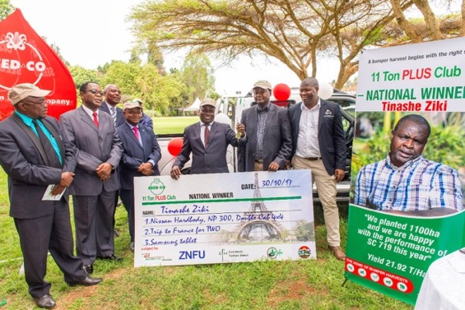
Yields agenda
SBU Updates- Zimbabwe
Yield records were broken for SC 727; 719 and 608 on the 11mt plus club competition.
2 farmers surpassing 20mt per hectare mark - SC727 and SC719.
90% of seed production - under irrigation

Slide 37
SBU Updates contd
Zambia
The local maize seed sales reduced by 31% due to:
  Late roll out of the e-voucher program, with the bulk of the activations in late December and January,
  The maize commodity prize slumping to a low of $120, and thus dissuading farmers from planting
  Drought during the planting period from mid-December to 25 January
  Delayed payments by the Food Reserve Agency leaving farmers with no cash to buy

Slide 38
SBU Updates contd
Zambia
Exports to other markets affected by varietal shortages
Gross margin down by 12% due to write downs and product mix resulting in profits reducing by 37,5%

Slide 39
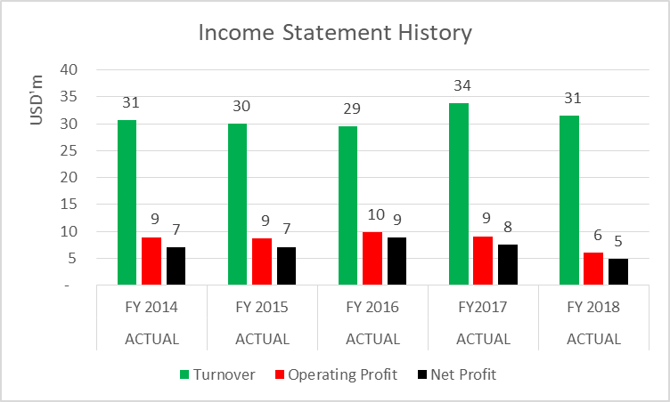
SBU Updates -Zambia .contd

Slide 40
SBU Updates contd
Malawi
the stronger Kwacha and better export opportunities and improved pricing resulted improved margins by 4%
Reduced interest bill by restructuring the borrowings mix
Earnings were $1m as compared to prior year loss

Slide 41
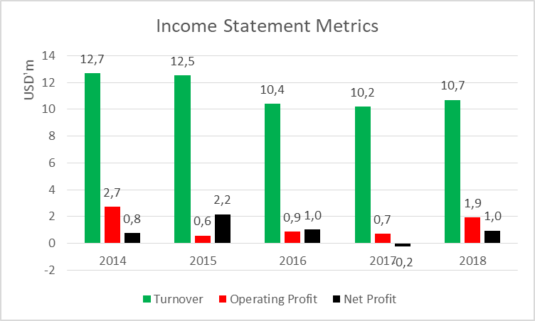
SBU Updates-Malawi. contd

Slide 42
SBU Updates continued
Kenya
  While demand was buoyant as farmers needed to replant following the drought, the SBU experienced serious stock shortages in all the popular varieties.
  gross margin down 5% due to product mix and some write downs of some seed stocks resulting in earnings reducing by almost 50%

Slide 43
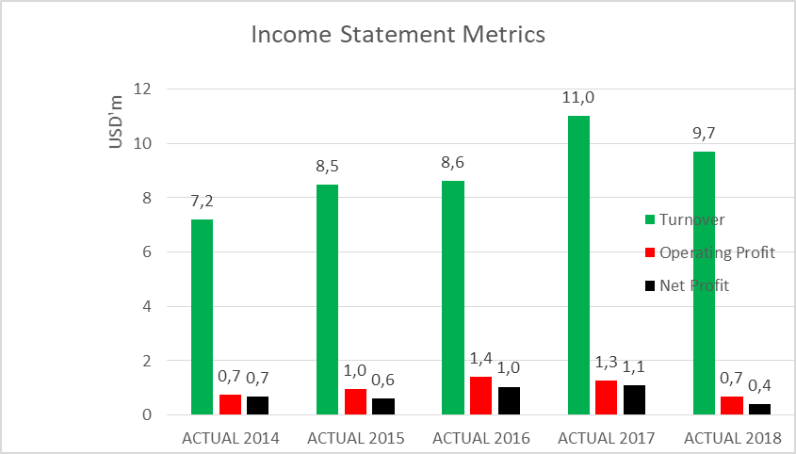
SBU Updates-Kenya. continued

Slide 44
SBU Updates contd
Tanzania
  Turnover was slightly higher than prior year due to amplified demand on the back of the drought experienced last year coupled with aggressive marketing efforts to increase footprint in this country’s vast untapped potential
  Increasing activities in the Southern highlands – Tanzania's bread basket
  Increased local production enhanced margins resulting in 30% increase in profits

Slide 45
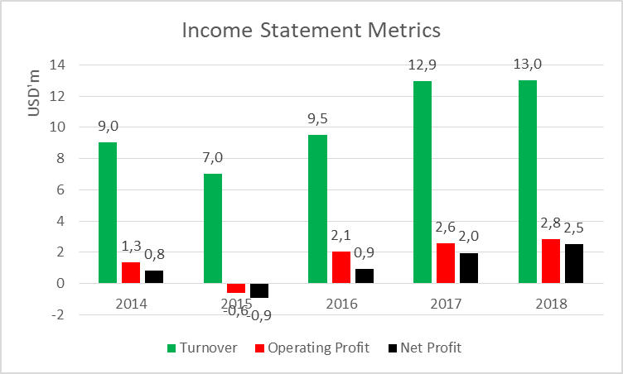
SBU Updates-Tanzania. contd

Slide 46
SBU Update contd
CCU
  ISPAAD program in Botswana replaced with tender business which was cut-throat
  Business affected by product shortages during the year

Slide 47
SBU Updates contd
Prime Seeds
  JV achieved a breakeven position

Slide 48
SBU Updates Contd
Quton
  40% associate
  Benefited from a Govt order of over 8000mt
  $1,3m contribution to Group profit
  Tz and Malawi still struggling
  Technology and skills transfer from Mahyco in progress

Slide 49
Outlook
Earnings to be maintained:
Improved seed supplies in most markets
Continuation of the Command Agriculture programme in Zimbabwe
Continued market share growth in East Africa;
Nigeria beginning to make contribution to group numbers and
Adoption of vegetable seed hybrids across the markets we serve.

Slide 50

QUESTIONS????

